Slide 1



PORTFOLIO 1:
COMPUTER
SCIENCE
BS CS - 1
GERI GIAN EPANTO
as Discipline, Computing Disciplines and Majors.

Slide 2

COMPUTER SCIENCE
AS A DISCIPLINE

Slide 3
COMPUTER SCIENCE
The study of computers, computational systems, and automated computation.
Computer science became a discipline in the early 1940s.
The field evolved through the establishment of theoretical foundations by many important historical pioneers, the invention of early computers, and the development of programming languages that formalized software development, solidifying computer science as a distinct discipline (Denning, 1999).

Slide 4
AS A DISCIPLINE
This discipline is frequently described as the systematic study of algorithmic processes that describe and transform information.
The fundamental question underlying all of computing is, What can be (efficiently) automated?
By the early 1960s, there was a sufficient body of knowledge to merit the first academic departments and degree programs. This discipline is also called computer science and engineering, computing, and informatics (Denning, 1999).

Slide 5
An Overview of the 5 Computing Disciplines and Majors
Although being a very new discipline, computing has expanded rapidly over the past few decades. Where it gave birth to multiple disciplines and majors. Which are:
1 | Computer Engineering
2 | Computer Science
3 | Information Technology
4 | Information Systems
5 | Software Engineering

Slide 6
COMPUTER ENGINEERING
Computer Engineers are focused on the connection between hardware and software. The emphasis and concern lies with the design and construction of computers and embedded systems.
Computer Engineers apply engineering theories to the problems of designing computers and computer-based devices. This is a theory-driven practice which incorporates traditional engineering and mathematics.

Slide 7
COMPUTER ENGINEERING
Compared to the other Computing Disciplines, Computer Engineering gives the most emphasis on Hardware, specifically computer architecture and infrastructure, from the applied to the theoretical aspects.

Slide 8
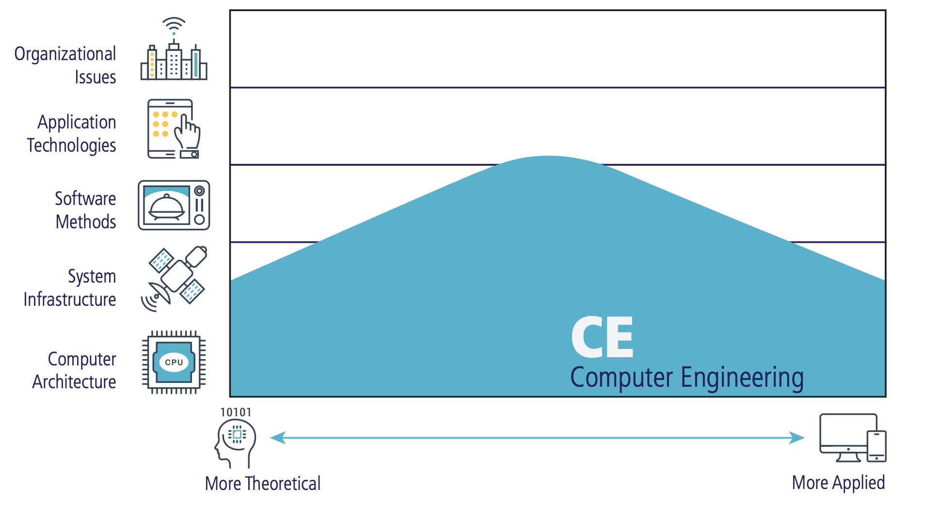
Source: Computing Disciplines: A Quick Guide for Prospective Students and Career Advisors (Connolly, Miller, Uzuka)

Slide 9
COMPUTER SCIENCE
Computer Science develop a strong foundation based on mathematics and algorithms. This program spans the range from theories through programming to cutting-edge development of computing solutions.
This is a program that focuses on the study of algorithms, programming, data structures, and computational theory, equipping students with the skills to design, develop, and optimize software and hardware systems.

Slide 10
COMPUTER SCIENCE
It focuses and gives most emphasis on the theoretical aspects of computing, which aids computer scientists the use of mathematical approaches to invent and improve new algorithms.

Slide 11
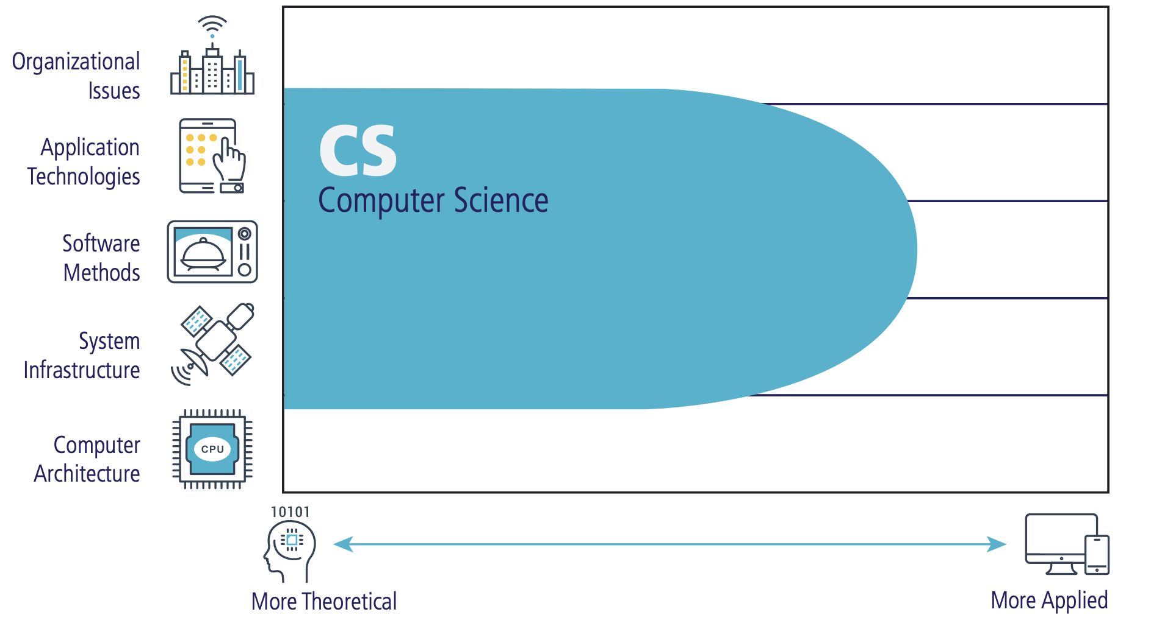
Source: Computing Disciplines: A Quick Guide for Prospective Students and Career Advisors (Connolly, Miller, Uzuka)

Slide 12
INFORMATION TECHNOLOGY
Information Technology (IT) professionals provide customer service with a focus on technology. They are responsible for planning and managing the entire technology lifecycle.
This program aids students with experience in both hardware and software which prepares them to meet the technological needs of businesses and organizations of the real world.

Slide 13
INFORMATION TECHNOLOGY
IT professionals possess both knowledge and practicality, hands-on expertise to take care of both an organization’s technological infrastructure and the people who use it.

Slide 14
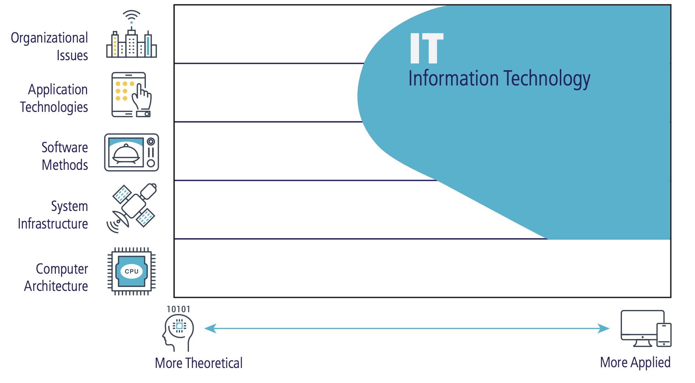
Source: Computing Disciplines: A Quick Guide for Prospective Students and Career Advisors (Connolly, Miller, Uzuka)

Slide 15
INFORMATION SYSTEMS
Information Systems specialists integrate computing knowledge and expertise with business processes. They focus on the processing of information, and must have a solid foundation of how organizations and technology work.
This discipline’s perspective on information technology emphasizes information, and views technology as an instrument for generating, processing, and distributing information.

Slide 16
INFORMATION SYSTEMS
This program aids students in becoming an effective bridge between the management and technical communities within an organization.
Information Systems is focused on the organizational issues of computing and technology. Information Systems also has an interest in the applied aspects of application technologies and software development.

Slide 17
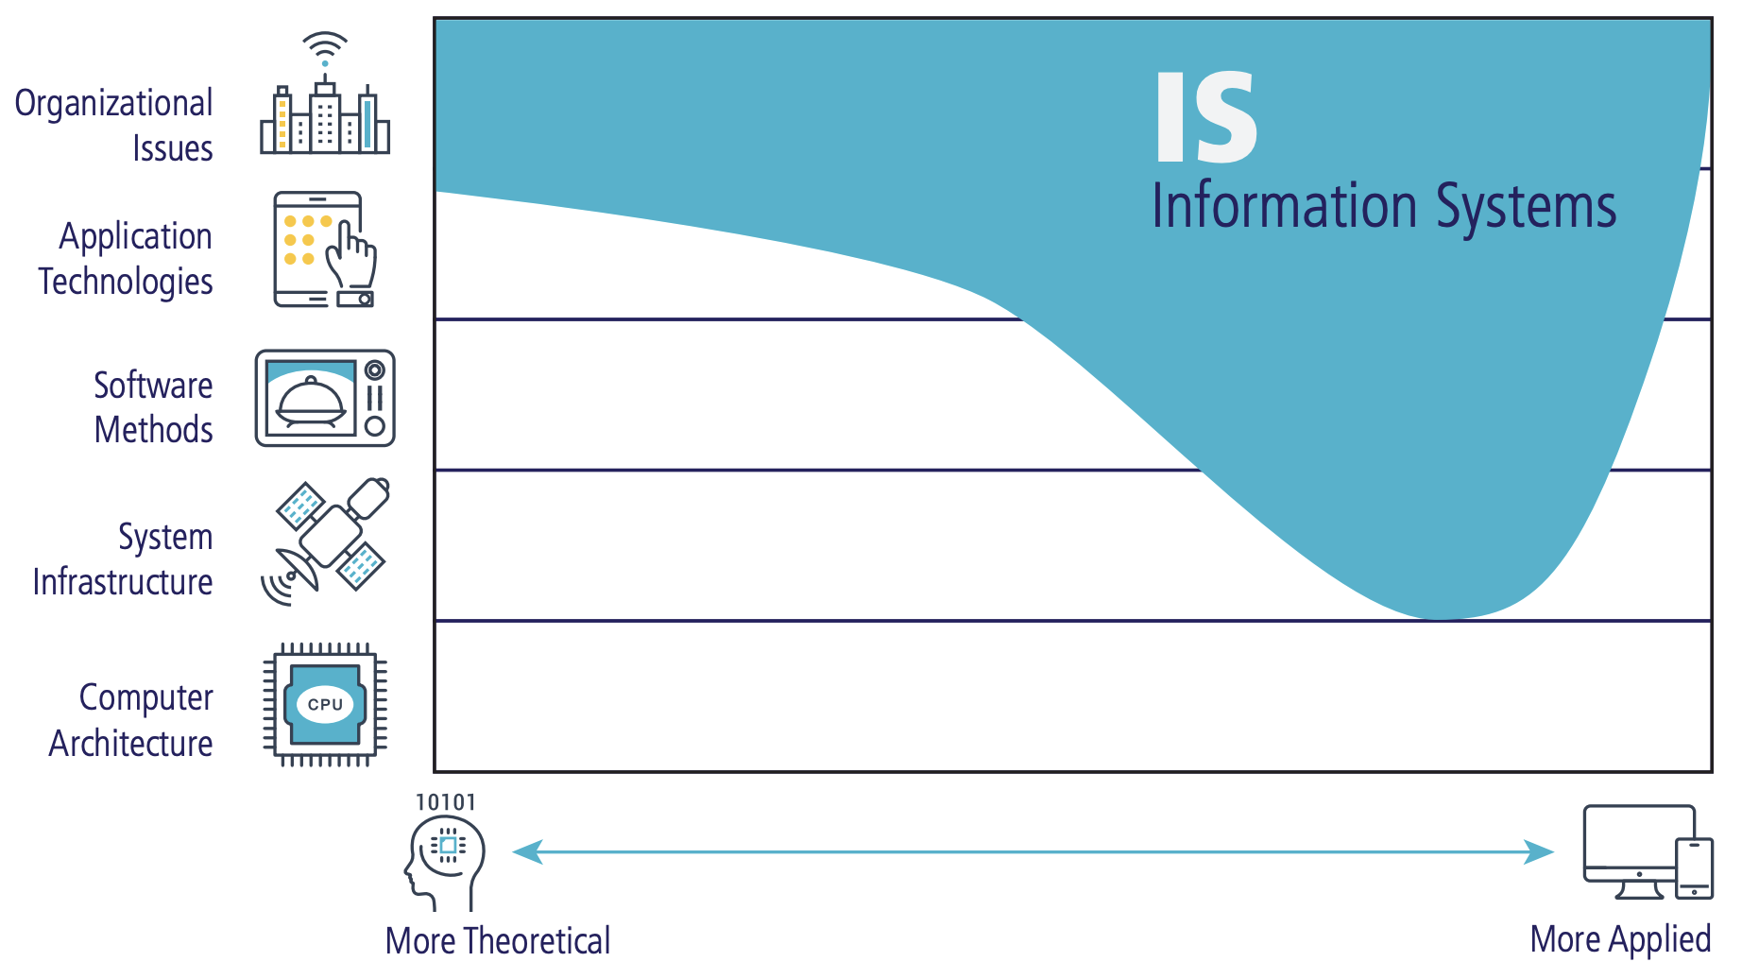

Source: Computing Disciplines: A Quick Guide for Prospective Students and Career Advisors (Connolly, Miller, Uzuka)

Slide 18
SOFTWARE ENGINEERING
Using the principles of mathematics and computer science, and the practices of engineering, software engineers effectively develop and maintain large-scale software systems that meets customers’ needs.
Software Engineering students learn about software reliability and maintenance, and focus more on the best techniques in writing software for engineering software applications.

Slide 19
SOFTWARE ENGINEERING
Software engineering is the systematic application of engineering principles to the design, development, testing, and maintenance of software, aiming to create reliable, efficient, and scalable software solutions.

Slide 20
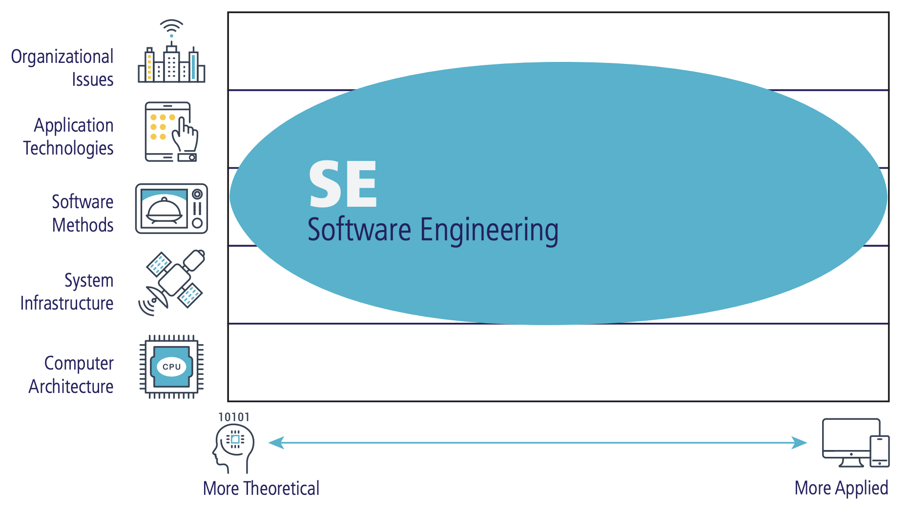
Source: Computing Disciplines: A Quick Guide for Prospective Students and Career Advisors (Connolly, Miller, Uzuka)

Slide 22
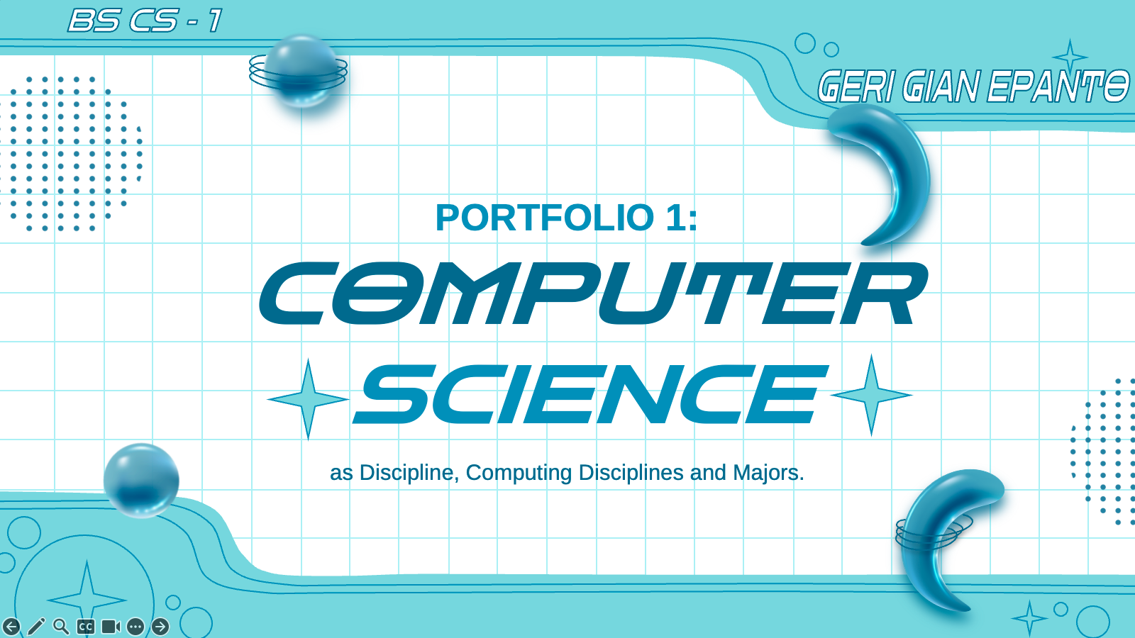
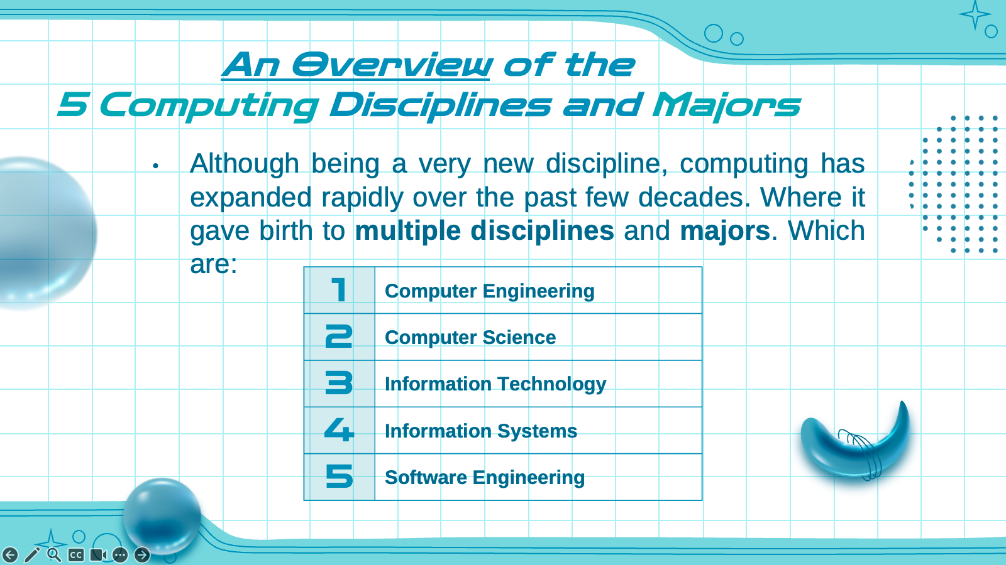
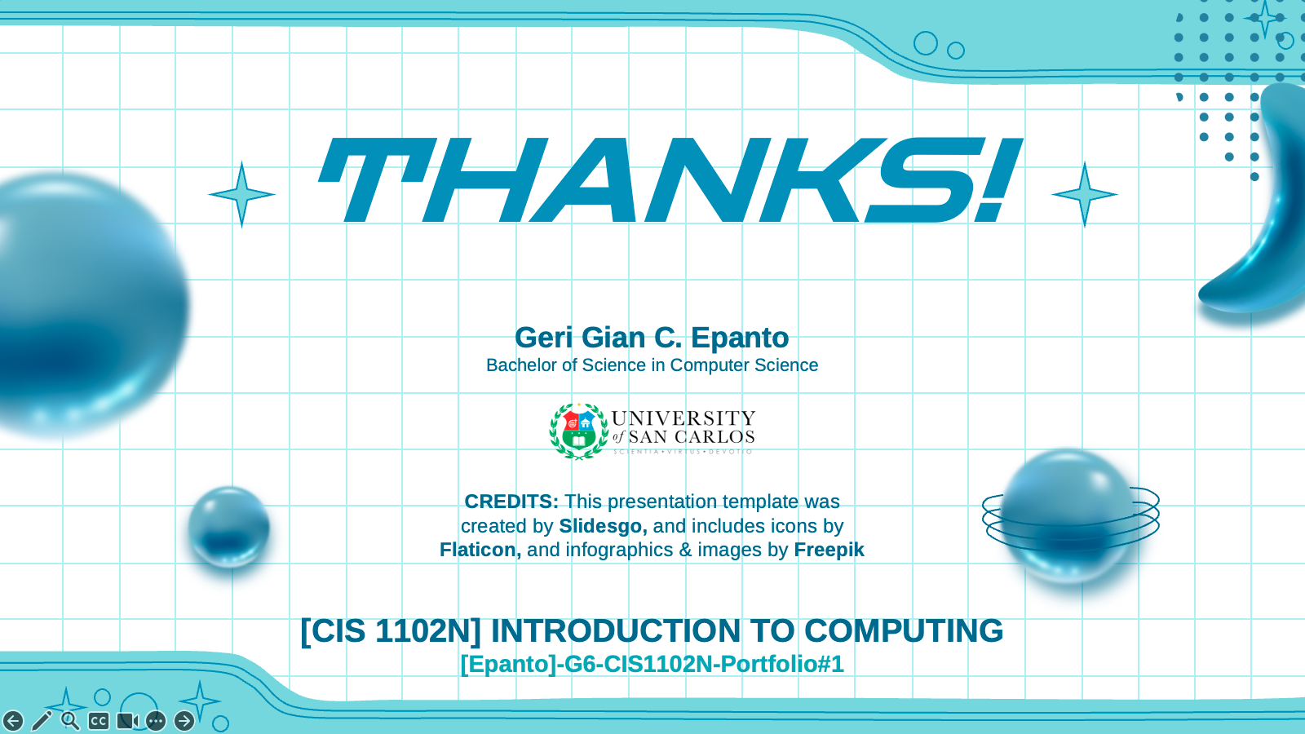
REACTION/ANALYSIS
The world of Computer Science (CS) has become one of the most thrilling disciplines of our time. Despite being relatively new compared to other established fields and its immense potential to change our future. CS has 5 computing disciplines and majors: computer engineering, computer science, information technology, information systems, and software engineering. Although these programs share a lot in common, each has different roles and purposes within the field. Being well-versed in the differences is an important aspect of appreciating their unique contributions not only to this field but how it can rapidly change the future.
Computer Engineering emphasizes more on the connection between hardware and software. The emphasis and concern lies with the design and construction of computers and embedded systems. This is a theory-driven practice that incorporates traditional engineering and mathematics. On the other hand, Computer Science, being the most popular on the list, aims to develop a strong foundation based on mathematics and algorithms. This program spans the range from theories through programming to cutting-edge development of computing solutions.

Slide 23
REACTION/ANALYSIS
Information Technology aims to aid students with experience in providing customer service which focuses on software and hardware. IT professionals possess both knowledge and practicality, hands-on expertise to take care of both an organization’s technological infrastructure and the people who use it. While Information Systems specializes in integrating computing knowledge and expertise with business processes. These two computing disciplines, are a more specified discipline, in the context of real-world applications where students are prepared to meet the technological needs of businesses and organizations of the real world.
Software Engineering emphasizes the application of mathematics, computer science, and the practices of engineering. Software engineers effectively develop and maintain large-scale software systems that meet customers' needs. Software Engineering students learn about software reliability and maintenance and focus more on the best techniques in writing software for engineering software applications

Slide 24
REACTION/ANALYSIS
Crafting this portfolio has not only deepened my understanding of these diverse disciplines but has also solidified my appreciation for the unique path that I have chosen. Each program offers its own set of challenges and opportunities, but together they represent the full spectrum of possibilities within CS. This assignment has assured me of how incredible a field I am in.
In conclusion, Computer Science as a discipline is vast and varied, with each program playing a critical role in advancing technology. The diversity within CS allows for specialization while maintaining a shared commitment to innovation and problem-solving. This reflection has been a valuable reminder of the significance of my studies and the exciting future that awaits within the world of Computer Science.

Slide 25

GERI GIAN C. EPANTO
Education:
Pagadian City Science High School (2018 - 2024)
University of San Carlos (2024 - Present)
DOST-SEI Undergraduate Scholar
“ Computers have always been my passion. I love problem-solving and exploring new technologies, making Computer Science the perfect field to fuel my curiosity. ”
Notes:
Getting to Know you Slide

Slide 26
REFERENCES:
Computing Disciplines & Majors. (n.d.-a). https://www.acm.org/binaries/content/assets/education/computing-disciplines.pdf
Connolly, R., MIller, J., & Uzoka, F.-M. (2017). Computing disciplines: A quick guide for prospective students and career advisors. CERIC.
Denning, P. J. (1999, July). Computer science: The discipline - the denning institute. Computer Science: The Discipline. https://denninginstitute.com/pjd/PUBS/ENC/cs99.pdf

Slide 27
REFERENCES:
Quality Criteria’s of computing disciplines. (n.d.-b). https://www.zuj.edu.jo/wp content/Researches/Quality%20Criteria’s%20of%20Computing%20Disciplines.pdf
University, S. M. S. (n.d.). Computer science: Disciplinary perspective. Computer Science: Disciplinary Perspective | English 251 Open Textbook | Southwest Minnesota State University. https://otb.smsu.edu/sections/section2-disciplinary-perspectives/computer-science/computer-science-home.html
What distinguishes each of the major computing ... (n.d.-c). https://www.laccei.org/LACCEI2008-Honduras/Papers/CD092_Lunt.pdf
When did computer science start?. Noodle.com. (2024, March 26). https://resources.noodle.com/articles/when-did-computer-science-start/

Slide 28

THANKS!
Geri Gian C. Epanto
Bachelor of Science in Computer Science
[CIS 1102N] INTRODUCTION TO COMPUTING
[Epanto]-G6-CIS1102N-Portfolio#1

